Slide 1
Practical Algorithm Analysis for Oracle Developers
281
Jon Heller
Database Administrator
Ventech Solutions
jon@jonheller.org
2019-04-10

Slide 2
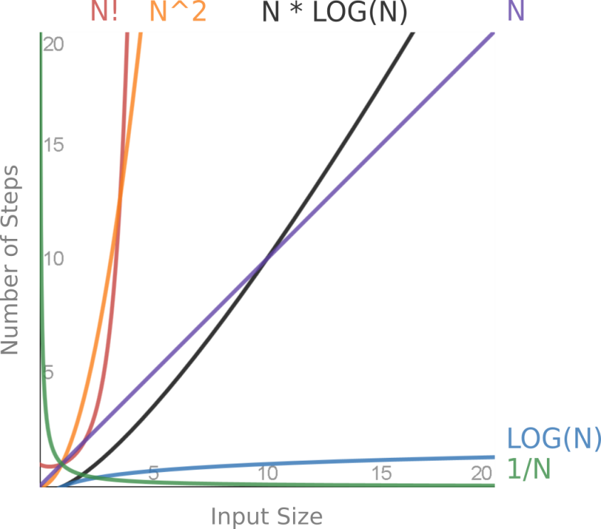
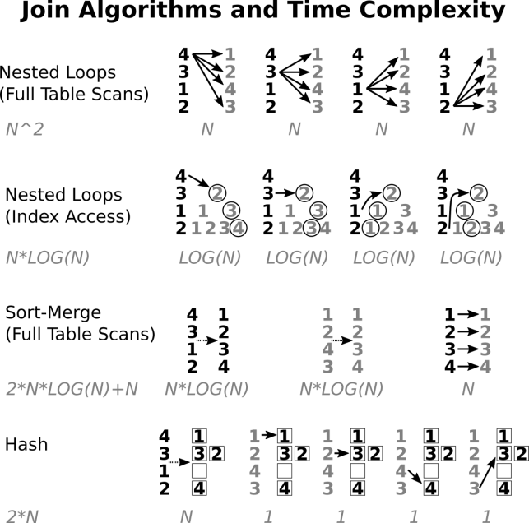
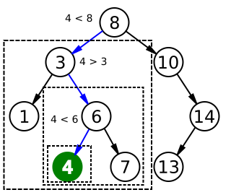
Practical Algorithm Analysis for Oracle Developers
Notes:
These images will all be discussed later.
(Binary search algorithm image created by Chris Martin and is in the public domain.)

Slide 3
Disclaimers
This is not a computer science lecture
No proofs or complicated math
Imprecise terminology: computational complexity, algorithm analysis, time complexity, asymptotic complexity, run-time analysis
Notes:
Although I have a BS and MCS in computer science I'm not an expert in algorithm analysis, and this is not a computer science lecture.
This presentation focuses on practical information, even though this is usually taught as a theoretical subject.
I'm sure I'm mixing up terms, but it shouldn't matter. And there's some overlap between Oracle terminology and computer science terminology. For example, and "operation" in Oracle means an algorithm used in an execution plan. Whereas an "operation" in algorithm analysis means a single unit of work, like adding or comparing numbers.

Slide 4
Presentation is Based on Chapter 16
Notes:
https://www.amazon.com/Pro-Oracle-SQL-Development-Practices/dp/1484245164/
https://www.apress.com/us/book/9781484245163
This book should be out in late April, 2019.
This chapter is not truly representative of the book. The book focuses on SQL development processes, advanced features, style guidelines, and tuning.

Slide 5
Tuning is Hard
Most tuning is based on business logic, dev process, advanced features, and styles
Breadth-first approach needed
Find first significant problem (measure, don't guess)
Many tuning styles are necessary
Algorithm analysis is foundational
Notes:
Most tuning happens long before you ask for execution plans. Writing clear code is the best way to write fast code.
Performance tuning is different than troubleshooting. With troubleshooting, we can find the smallest possible problem and drill-down infinitely until we find the cause. For bug hunting, every fix helps, and we can have a utopian view of our code. But that approach will never work for performance tuning, where everything takes up time and there are always red herrings.
We must only look for the first significant problem, which is where experience makes a big difference.
For tuning, we need to try multiple styles quickly: system tuning, database tuning, SQL tuning, looking at cardinalities, phone-a-friend, resource consumption, etc.
Algorithm analysis is not the most important tuning method, but it's a helpful piece that everybody leaves out. It's good to have a simple mathematical description of the foundation of our problems.

Slide 6
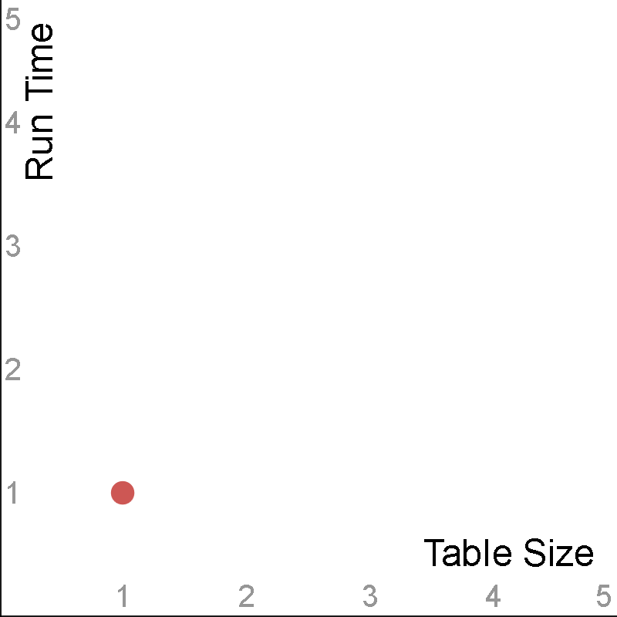
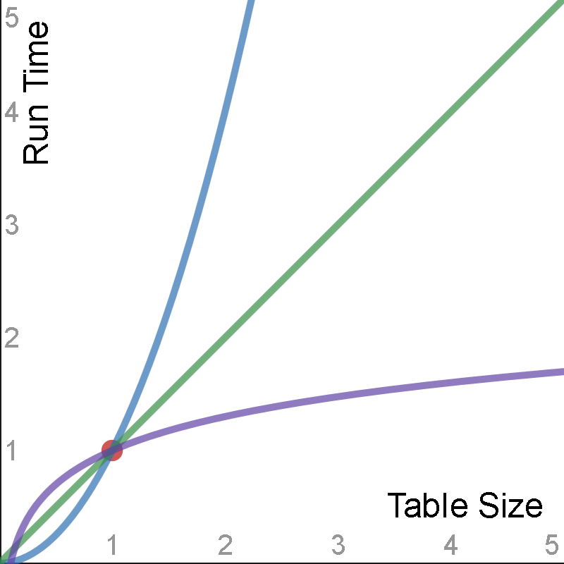
The Stakes are High
Orders of magnitude differences
"a million times faster" is only the beginning
Think about slopes, not points
Notes:
Programming is one of the few fields with orders of magnitude difference in skill level between professionals. We’ve all had to deal with coworkers who are only one tenth as productive as us, and we’ve all been humbled by developers whose code is ten times better than ours. With performance tuning those numbers get even higher, and the rewards are greater. It’s exhilarating when we make a small tweak and something runs a million times faster.
We like to talk about things being "X times faster or slower", but that's only the story at a single point-in-time.
We need to think about the slope instead of a single point. We want to know how is our application going to grow with the data size.

Slide 7
Run-time Analysis Theory
Simple math
Focus on run-time*, not space
Big O notation - function that describes the worst case
Replace ratios with functions
A few functions describe every database feature
Useful for both proactive and reactive tuning
Focus on practical, not theoretical
Ignore a LOT of implementation details and constants
Notes:
Although algorithm analysis is usually taught in college it only requires high school math. And most of the hard work has already been done for us. For example, it's already been proven that sorting cannot be done faster than O(N*LOG(N)), we don't need to re-prove it here.
Most of this presentation is about time. Although space can be important, and will occasionally be discussed. There is an asterisk by run-time because we're not actually measuring the literal wall-clock time. Algorithm analysis depends on generic "steps", not seconds, minutes, or hours.
There are many different ways to describe these functions. For simplicity we will only use the Big O worst-case complexity.
Instead of saying "A is X times slower than B at point Y", we can say "A is O(N^2) and B is O(N)."
This presentation is going to ignore a ginormous amount of implementation details and constants. Those details definitely matter, and can sometimes override algorithm complexity, but in many cases we can ignore them.
A surprisingly small number of functions can describe every possible database operation, as we'll see later.
Algorithm analysis helps with proactive tuning because we need to know the advantages of different data structures - for example, why should we build indexes? Algorithm analysis is helpful for reactive tuning because we need to compare the algorithms and data structures that Oracle chose, and try to determine why it made a bad choice.
There are an infinite number of functions, this presentation only focuses on a small number of functions that are relevant for Oracle database operations.

Slide 8
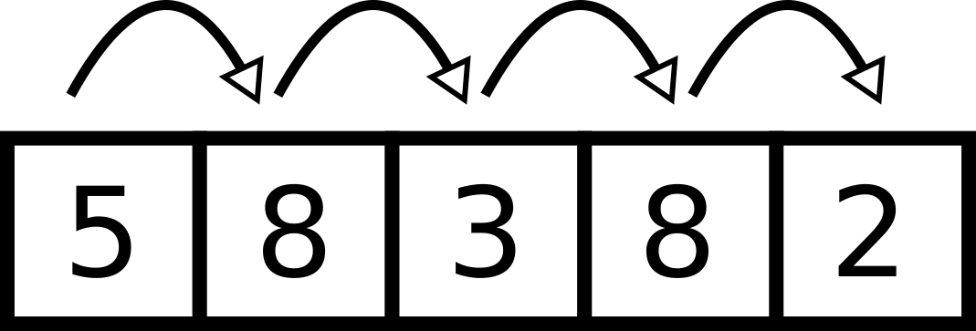
Run-time Analysis Example (1)
Linear search of array or heap table
--Find positions for "8".
declare
v_array sys.odcinumberlist := sys.odcinumberlist(5,8,3,2,8);
begin
for i in 1 .. v_array.count loop
if v_array(i) = 8 then
dbms_output.put_line(i);
end if;
end loop;
end;
/
Notes:
The simplest way to start with algorithm analysis is with a simple linear search algorithm. A FOR loop that goes from 1 to N uses N operations.

Slide 9
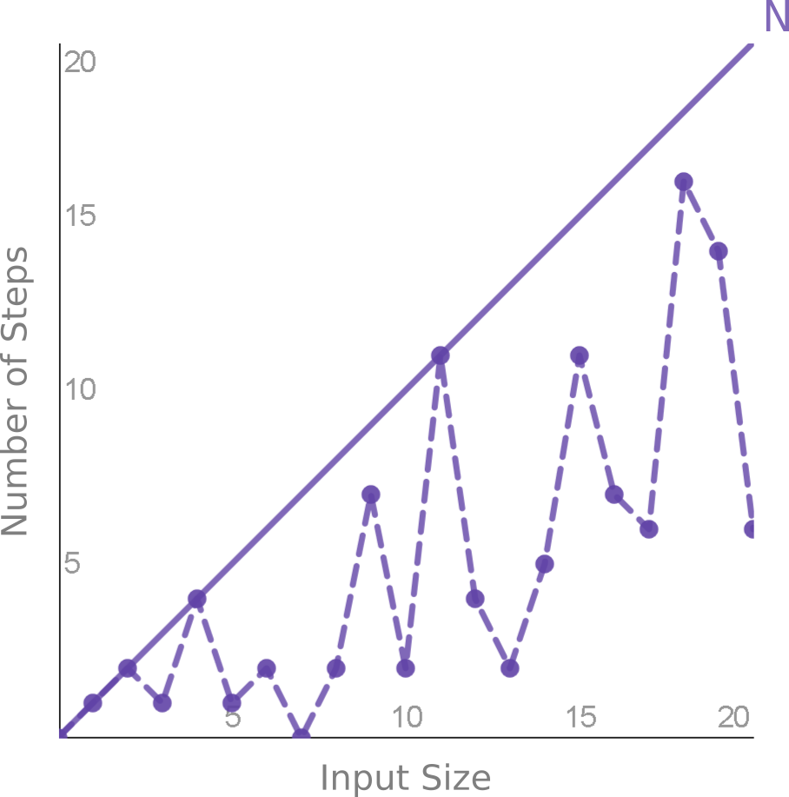
Run-time Analysis Example (2)
Best case is O(1)
Average case is O(N/2)
Worst case is O(N)*
Many lectures available online
Notes:
O(1) - If we're lucky we'll find the element immediately, and only need 1 lookup.
O(N/2) - On average we'll have to search half of the elements, N/2.
O(N) - If we're unlucky we have to search each of the N elements. Worst case is the most realistic. Unless we have a unique array or index, we have to continue searching through all N elements, even if we find a match. For example, in the previous slide there were duplicate values, one near the beginning, and one near the end.
This is not a full introduction to algorithm analysis. If you're interested in this topic I recommend you search for "algorithm analysis" and read one or two of the computer science lectures. The topic usually does not require a heavy math background.

Slide 10
A New Performance Story
Ignore database tuning, SQL tuning, advisors, reports, tools
Popular functions guide us through performance categories
Start with fastest and end with slowest
Notes:
Oracle performance tuning is a huge topic and there are many ways to teach it. Even listing and ordering the topics is a huge effort. Let's ignore the common tuning techniques and do something totally different.
We only need a small number of popular functions to describe almost every Oracle feature.
There are many ways to discuss performance topics, I've arbitrarily chosen to list the functions from fastest to slowest.

Slide 11
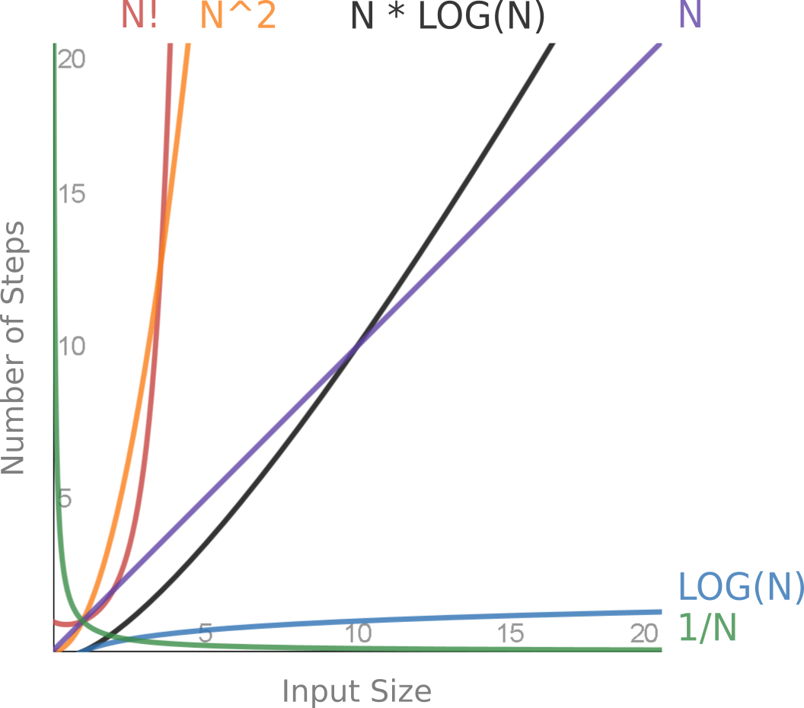
Popular Functions
Notes:
This graph shows the common functions described later in this presentation.
In addition, the presentation also covers O(1), O(∞), and Amdahl's Law. Those functions are either trivial or too hard to display.

Slide 12
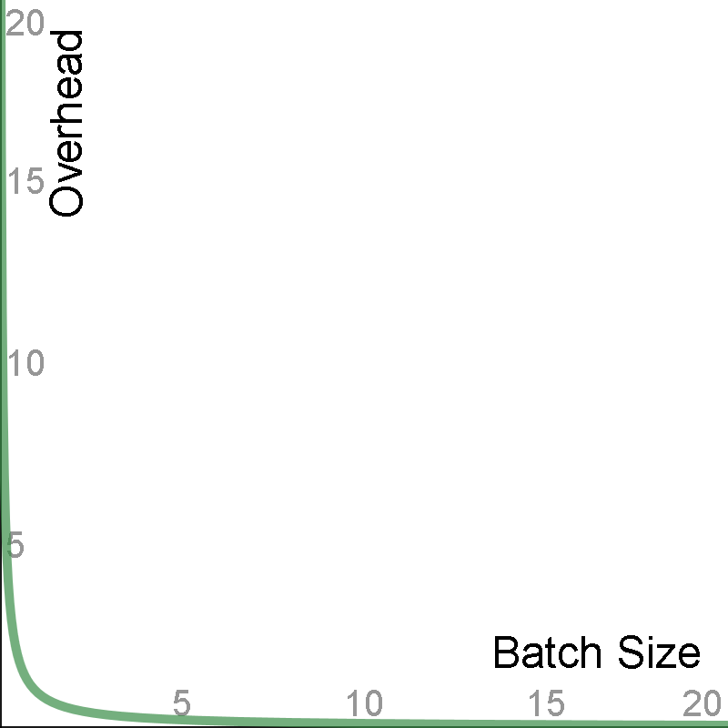
1/N
Notes:
Weird, contentious, fast: The first function is perhaps the weirdest, and most contentious topic, but also one of the most useful.
Different Axes: Almost all of the functions plot time versus input size, but this one is a bit different. In practice, sometimes Overhead versus Batch Size is more important than Run Time versus Input Size.
Boring: This graph may look boring, but boring is good. We want things that quickly go to zero.
Fast, left vs. right: Notice how quickly the line approaches 0 on the y-axis. If we find ourselves in one of these situations we must try very hard to not be on the left-hand side, but we don't have to go very far on the right-hand side.

Slide 13
1/N - What and Where
Harmonic progression
Context switching for every N items
(Overhead analysis, not run-time analysis)
(N * REAL_WORK) + ((N * OVERHEAD_TIME) / BATCH_SIZE)
Any process with a tunable batch or cache size
Sequences, bulk collect limit, prefretch, arraysize, UNION ALL, DBMS_OUTPUT, DBMS_SCHEDULER, etc.
Notes:
1/N is called the harmonic progression. (The harmonic series is much more common, but we're not doing a series here, just one batch size at-a-time.)
Context switching is a performance killer for so many applications. It's a huge topic that applies to much more than just database development. Anytime we can process in bulk, or build an assembly line, there are so many optimizations available.
This is not technically a "run-time analysis", this is more like an "overhead-analysis". But there is a strong relationship between the two, since many operations are completely dominated by overheard instead of the real work.
For the total amount of work we need to measure two things - the "real work" and the overhead. Every operation always has some actual work that is inevitable. For example, with an INSERT, obviously we have to spend time inserting the row. By overhead, I refer to things not directly related to the operation, like the time to generate a sequence needed for that INSERT.
There are so many operations that this applies to.

Slide 14
1/N - Why it Matters
Don't waste time trying to perfect this
Why does increasing batch size help?
BATCH_SIZE 2 = 50% optimized
BATCH_SIZE 10 = 90% optimized
BATCH_SIZE 100 = 99% optimized
Why ever go over 100? Trade space for (no) time
Most tests are wrong
Notes:
You don't need to test this every time. You can never get the perfect batch size, but luckily we can easily get one that's good-enough.
Think about why increasing the batch size helps. It helps by eliminating overhead. But there's only so much overhead to eliminate. There's always going to be the real work, which the batch size won't help with.
Going over 100 is almost certainly a mistake. Compare to no batching at all, you cannot theoretically improve the performance by more than 1%.
But then why do some test cases demonstrate further improvements? Only if they include absolutely no real work. (I've built guilty of this myself.)

Slide 15
Large Batch Sizes Shouldn't Help
If huge batches sizes help we're doing something wrong.
declare
v_count number;
begin
for rows in (select * from large_table) loop
v_count := v_count + 1;
end loop;
end;
/
Instead use: select count(*) from large_table
Notes:
If we find ourselves in a position where increasingly large batch sizes make a significant difference, then we're doing something wrong.
If we care too much about context switching, then maybe we're not using enough SQL.

Slide 16
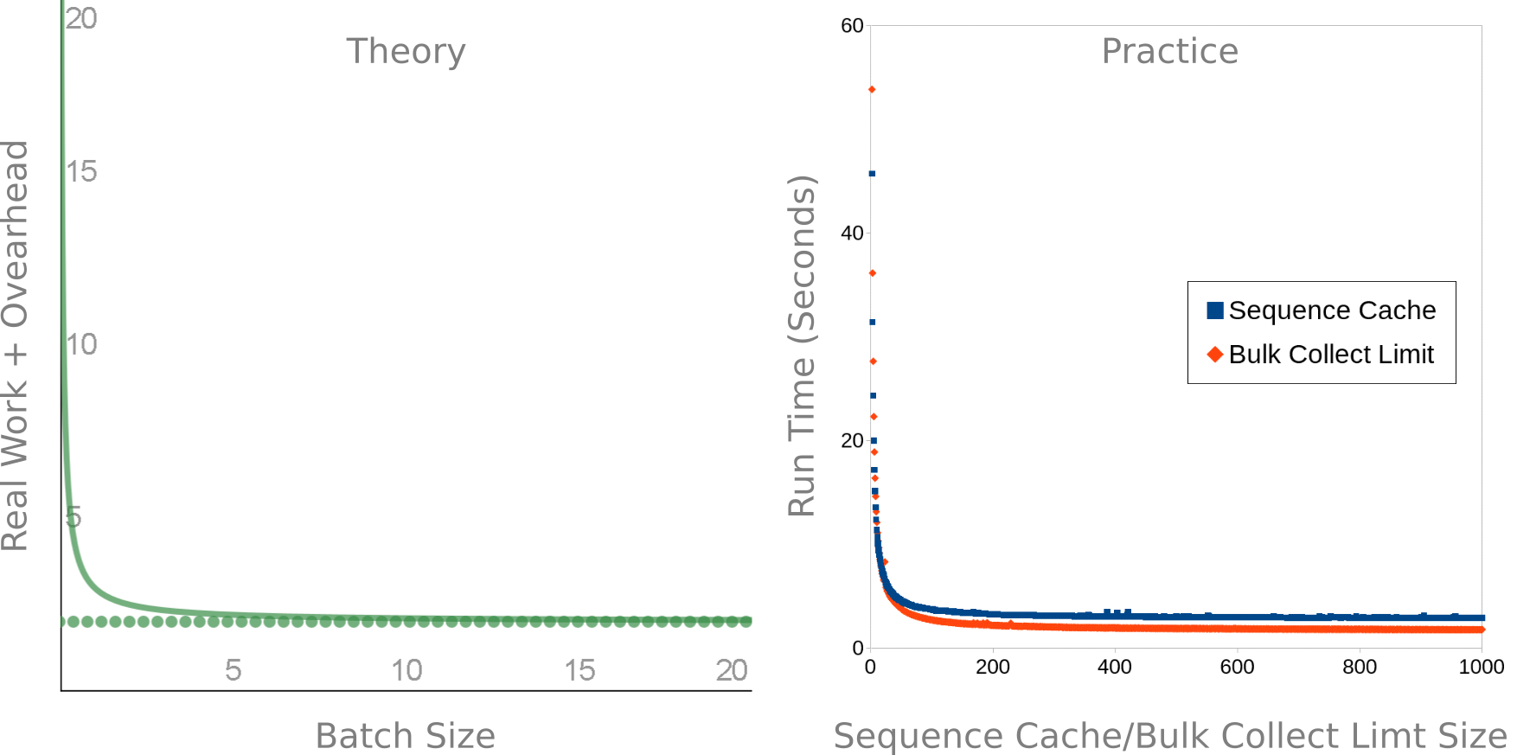
1/N - Theory vs. Practice
Notes:
Match: I built two test cases for sequence cache size and bulk collect limit. Notice how the theory and practice almost perfectly line up.
Plot it: It's important to build a test case with a huge number of points to avoid biases. If I randomly picked some different limit sizes, and re-ran a few times, I could prove anything I wanted to. But when the numbers are plotted out it becomes obvious what the trend is.
Asymptote: Notice the asymptotes at the bottom of the

Slide 17
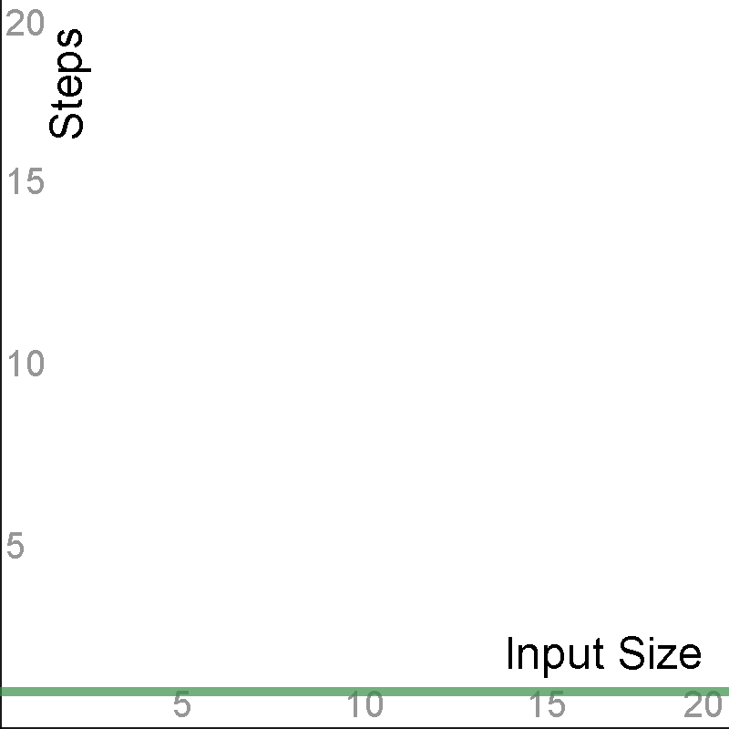
1
Notes:
This boring function was not even show in the comparison graph earlier.

Slide 18
1 - What and Where
Constant time - boring is good
INSERT VALUES*, CREATE, DROP, TRUNCATE, ALTER SESSION, etc.
Hashing (one value) - partitioning, hash clusters, joining/grouping/distinct
Notes:
Constant time means the run time does not depend on the size of the data - which is a great thing when it's possible.
This happens with lots of operations, mostly with DDL. It might happen with INSERT VALUES, unless the table has indexes that require extra work, or if the table is a cluster.
O(1) *could* happen for hashing in theory, but in practice it won't occur. This affects partitioning, hash clusters, and joins.

Slide 19
1 - Hashing
Map a value to a set of buckets
Useful for grouping, comparing, cryptography, etc.
select ora_hash('A', 100) from dual;
80
select standard_hash('A', 'SHA256') from dual;
559AEAD08264D5795D3909718CDD05ABD49572E84FE55590EEF31A88A08FDFFD
Notes:
Hashing is conceptually simple and generic - we take an input and we map it to an output.
Hashing is a core database operation and is used frequently. It's great for grouping data (like for GROUP BY, DISTINCT, hash partitioning), comparing (for joining, hash clusters), and hiding data (password hashes, de-identifying).
Oracle has several built-in hash functions, such as ORA_HASH, STANDARD_HASH, DBMS_CRYPTO, DBMS_SQLHASH, and probably others.

Slide 20
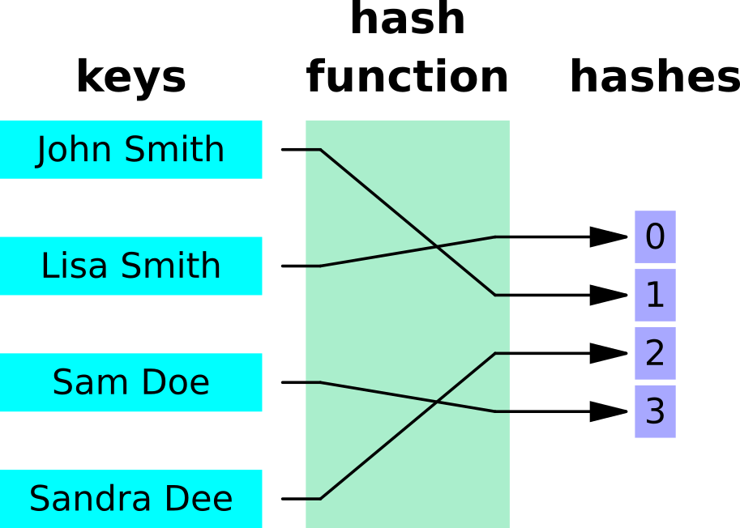
1 - Perfect, Minimal Hashing

Slide 21
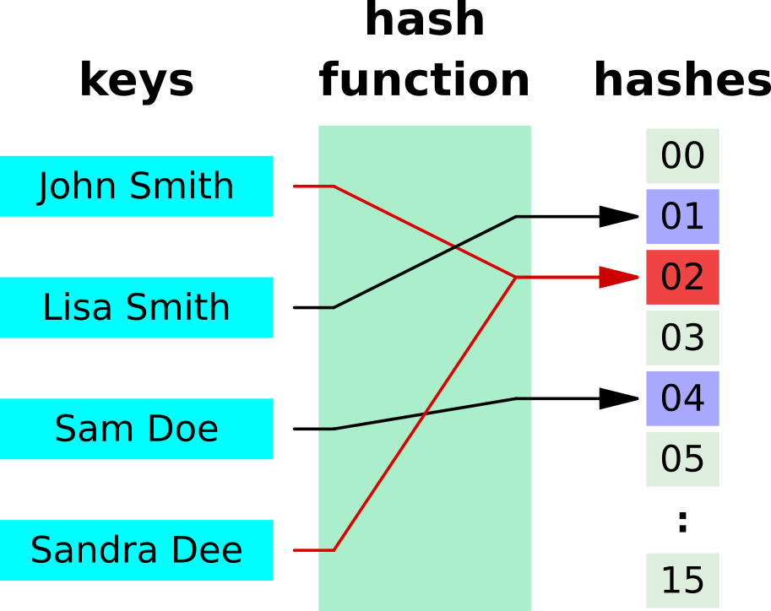
1 - Typical Hashing
Notes:
Note the extra buckets and collisions. The extra buckets waste space, and the collisions can decrease performance. If all of the keys go into the same bucket then the data structure is effectively the same as a regular heap table, and every lookup changes from O(1) to O(N).

Slide 22
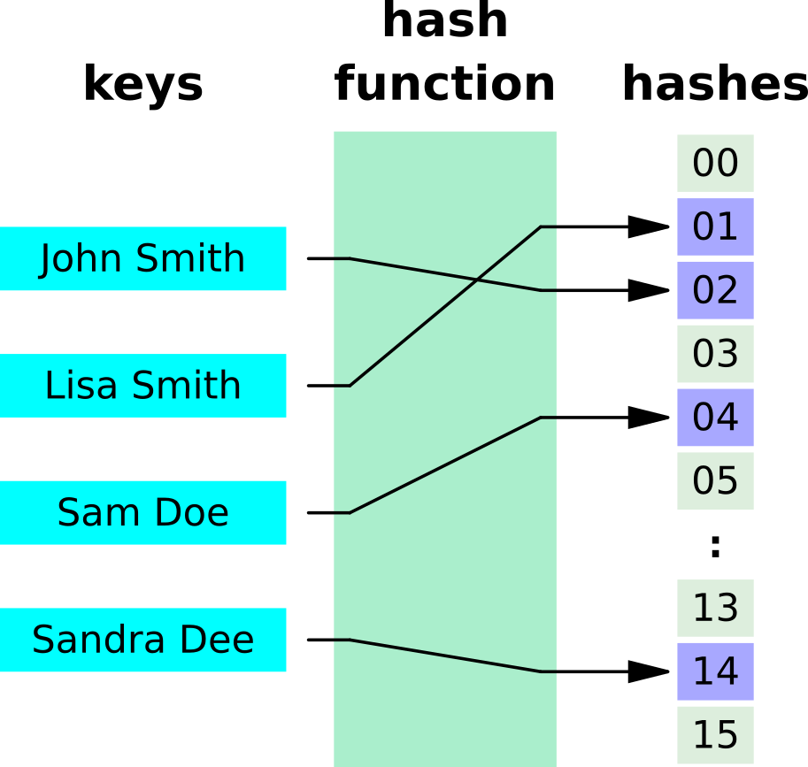
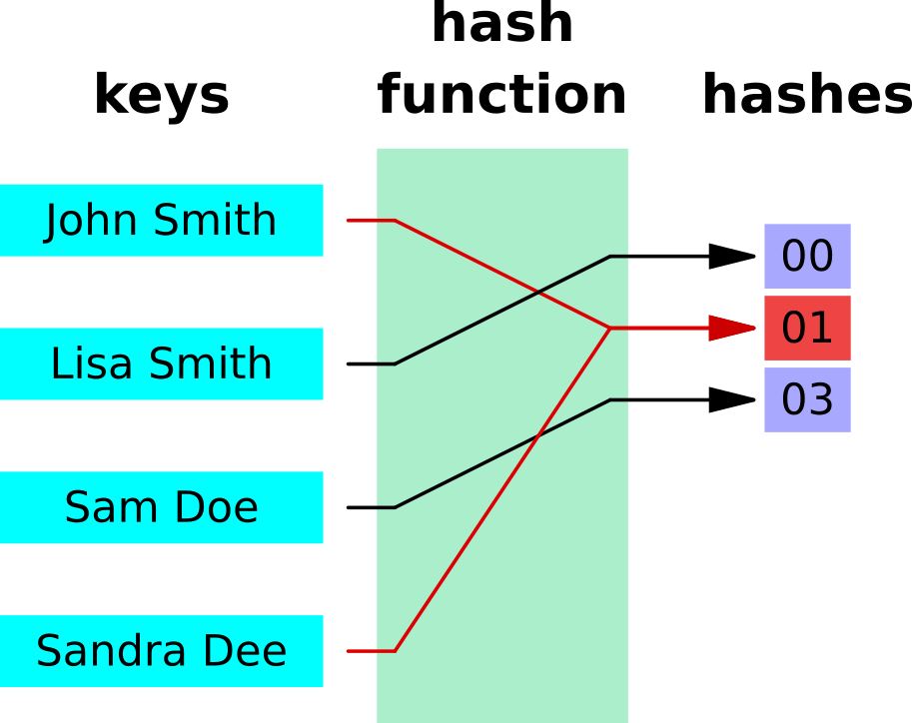
1 - Perfect vs. Minimal Tradeoffs
Notes:
There are many potential trade-offs in hash design.
If we go for a perfect hash, where everything goes to one bucket, the lookup time is O(1). But it wastes a huge amount of space.
If we try to minimize the hash, and not waste any space, there are many duplicates and the lookup time is between O(1) and O(N).

Slide 23
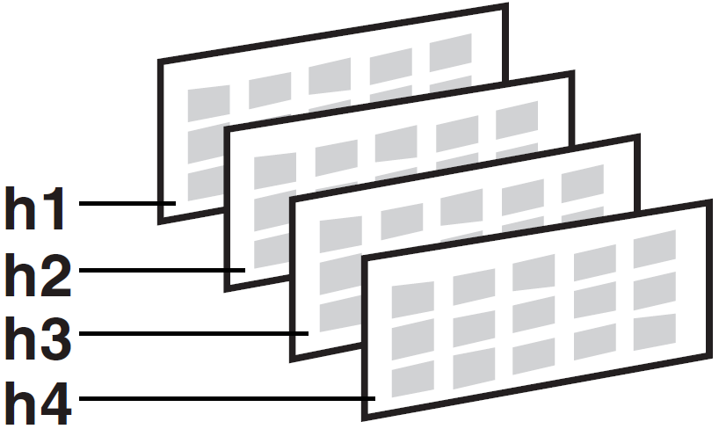
1 - Hash Partitioning
Minimal: Yes, Perfect: No
Trades time for space
ORA_HASH
Good for retrieving large percentage of rows
Insert O(1), read is O(N/#_PARTITIONS)
Don't use huge number of partitions (wastes space, breaks data dictionary)
Notes:
Hash partitions are minimal but not perfect. This means they don't waste much space and many values hash to the same bucket. An Oracle partition uses the same physical structure as a table - they are both segments, which are potentially large things.
Assigning a value to a partition is lightning fast, but retrieving a value is potentially slow. Reading from an entire partition can be slow.
The value of partitioning is for reading a large percentage of data. Hash partitioning allows full table scans on small tables. Indexes are good for reading a small percentage of data.
Do not try to cheat the system! Don't think you can get O(1) read time by using a huge number of partitions. That will waste a *ton* of space, since each unused bucket is a segment. And the data dictionary is not equipped to deal with a ginormous number of objects. This can be a problem in large data warehouses with over-zealous partitioning - random data dictionary operations will slow to a crawl and can be slower than actual data operations.
(Image from the Oracle manual, from https://docs.oracle.com/cd/B28359_01/server.111/b32024/partition.htm. There are many other kinds of partitioning discussed there.)

Slide 24
1 - Hash Clusters
Minimal: No*, Perfect: Maybe*
Trades space for time (otherwise just use an index)
Custom or internal hash function
Good for retrieving small percentage of rows
O(1) reads, theoretically better than indexes
In practice it's slower (constants win)
Creating perfect hash inconvenient, increases table size 3x*
Maybe a hash index in a future version?
Notes:
Hash clusters are designed for perfection, not minimalism. Hash clusters deal with rows (or maybe block?), not entire segments.
Hash clusters can be set either way, but there's no point in having a hash cluster that is minimal but not near-perfect - just use an index instead.
The hash function can be custom or you can let Oracle use a function, and specify properties like the number of keys.
With a large, perfect hash cluster the lookup time for a small percentage of rows can be awesome.
We can build hash clusters that have O(1) reads (as measured by consistent gets), which is theoretically even better than indexes (which are discussed next).
Yet in practice O(1) hash cluster lookup is still slower than O(LOG(N)) index reads. I'm not sure why this is. When the functions are small, like comparing O(1) with O(LOG(N)), the constants can become more important. I'd guess that Oracle has spent much more time optimizing indexes than hash clusters. This is probably why nobody uses hash clusters anymore.
In my example, I had to create a table that was over three times as large to get an average of O(1) perfect hashing.
While hash clusters are great in theory, they don't work out well in practice. It's terribly inconvenient to re-organize tables, even for experimenting. Compare that with an index, which is an optional data structure. And I had to make the table size 3x as large to get perfect hashing - but that was just my one example. Maybe there's a better way to do it.
Hopefully a future version of Oracle will introduce hash indexes, which might finally allow O(1) lookup time without the penalties.
See this Stack Overflow answer, where I try and fail to create a useful constant-time index using hash clusters: https://stackoverflow.com/questions/32071259/constant-time-index-for-string-column-on-oracle-database

Slide 25
1 - Hash Joining/Grouping/Distinct
Minimal: No, Perfect: No
Somewhere between O(1) and O(N)
In practice, best way to join/group/distinct large data
Discussed later in O(N*LOG(N))
Notes:
Oracle has at least three different hash operations - HASH JOIN, HASH GROUP BY, HASH UNIQUE. I suspect they all use similar hashing algorithms, but I'm not sure.
This hashing mechanism is somewhere in-between the trade-offs. It's hard to say exactly how good it is, it depends on the data.
At the end of the day, what matters is that it's almost always the best way to deal with large data.

Slide 26
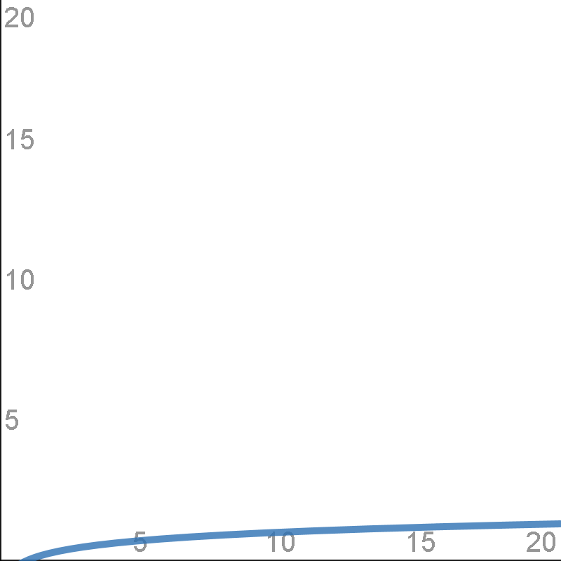
LOG(N)
Notes:
Logarithms are the inverse of exponentiation. We're still in the slow-growing functions, and we're still only discussing single-item operations, like looking up a single value.

Slide 27
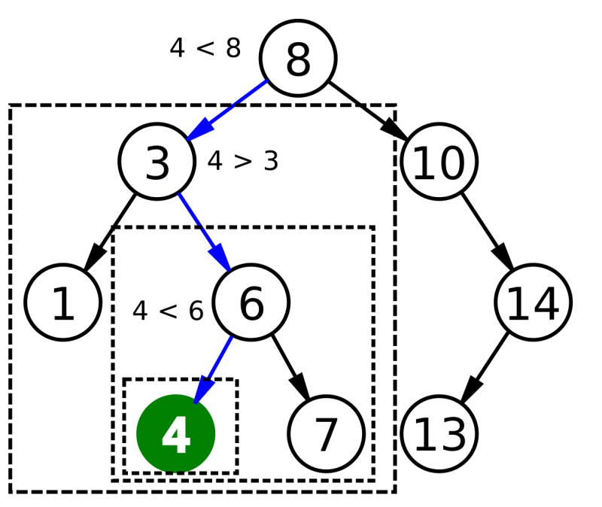
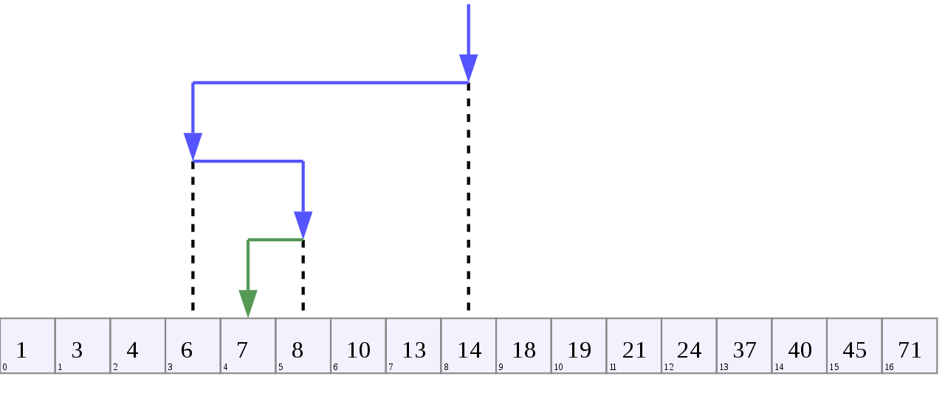
LOG(N) - B-Tree Visualizations
Notes:
The most common LOG(N) operation is a B-Tree lookup.
It's easiest to visualize a B-Tree index as a binary tree search. (The "B" in B-Tree does not stand for binary. Binary trees are just one kind of B-Trees.) Think of it like the children's guessing game - you want to eliminate as many numbers are possible each time, which halves the results.
(Binary search algorithm image created by Chris Martin and is in the public domain.)
(Binary Search Depiction by AlwaysAngry is licensed under the Creative Commons Attribution-Share Alike 4.0 International license.)

Slide 28
LOG(N) - What and Where
Binary math - each bit doubles
Binary search - each decision halves
Exponent and logarithm are opposites
Binary number 2^N, binary search LOG2(N)
Real indexes aren't binary, use LOG not LOG2
Notes:
In algorithm analysis the difference between LOG and LOG2 doesn’t matter that much. We don't need to know the base to make good decisions.

Slide 29
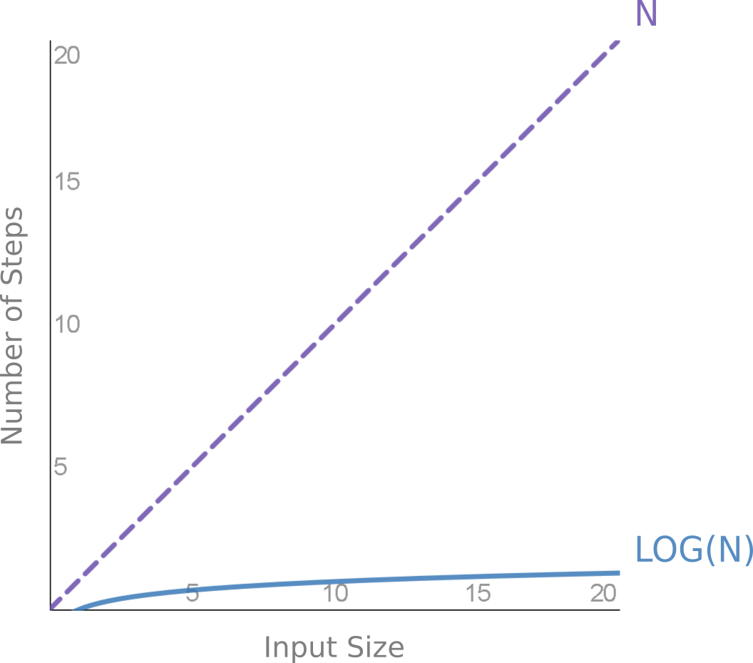
LOG(N) - Index vs FTS for Single Access
Notes:
This graph compares LOG(N) with N - comparing an index read with a full table scan. Note that we're still only talking about accessing a single value.
This graph only goes to 20 but show how indexes can be ridiculously faster than full table scans.
(As previously discuss, hashing could be faster for single access, but it isn't. Indexes are the best for single-access.)

Slide 30
LOG(N) - Why it Matters
This is why indexes are so fast
Data doubles, index access may stay the same
Create indexes proactively
One search is LOG(N), N searches is N*LOG(N) and is discussed later
Notes:
Index performance scales so well. A good index today may be a great index tomorrow, as the data grows.
It might be worth creating indexes that initially aren't valuable.

Slide 31
LOG(N) - Height of 3 Million Indexes
BLEVEL | Count
 | 899,972
0 | 2,097,419
1 | 245,841
2 | 42,303
3 | 2,601
4 | 54
5 | 24
6 | 25
7 | 3
9 | 1
11 | 1
Notes:
The height of the index determines the maximum number of steps, or hops, it takes to find a specific value.
This table shows that in practice it is extremely unlikely to have an index grow to more than 3 or 4 levels deep.
These indexes are from an environment where we do not periodically rebuild indexes. The chance of a rogue index, that requires constant rebuilding, is extremely small. For range-scan access you almost never need to worry about the index becoming inefficient.
Generated by this query (run against the 350 databases I have access to)
select blevel, count(*) count
from dba_indexes
group by blevel
order by blevel nulls first;

Slide 32
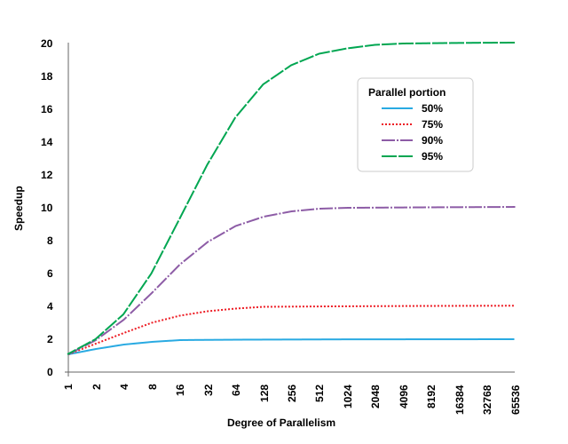
Amdahl's Law - 1/((1-P)+P/N)
Notes:
This graph is a bit different than the others - the X axis does not represent the amount of work, it represents the degree of parallelism. Notice that the X axis is logarithmic, and the Y axis is linear.
This graph takes a minute to understand. It's showing us how the maximum possible speedup depends on the degree of parallelism as well as how much of the process can be parallelized.
For example, if we only parallelize 50% of the workload, the theoretical maximum speedup is 2x.
(Amdahl’s law as a graph. Based on “Amdahl’s Law” by Daniels220, licensed under CC BY-SA.)

Slide 33
Amdahl's Law - Depressing Results
Must parallelize EVERYTHING
Diminishing hardware returns: 128 cores at 95% = 17.4x 256 cores at 95% = 18.6x
Focus on parallelizing instead: 128 cores at 96% = 21x
Notes:
In large data warehouses, Amdahl's law is why we can't have nice things. It's depressing how even the tiniest bit of serial work prevents us from fully utilizing our hardware.
These examples show that increasing the parallel portion is often more important than improving the hardware.

Slide 34
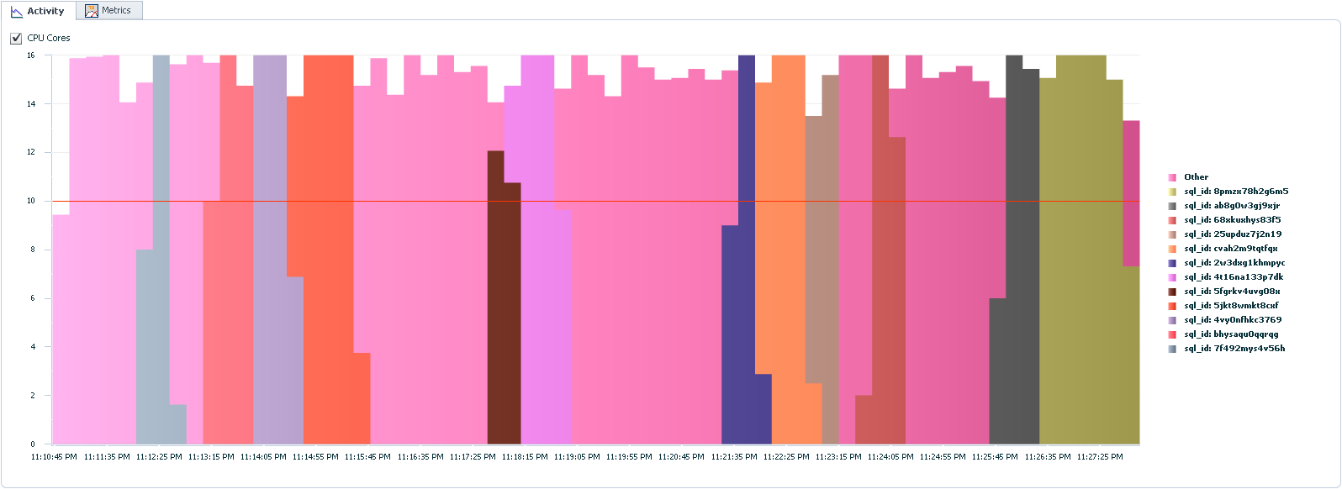
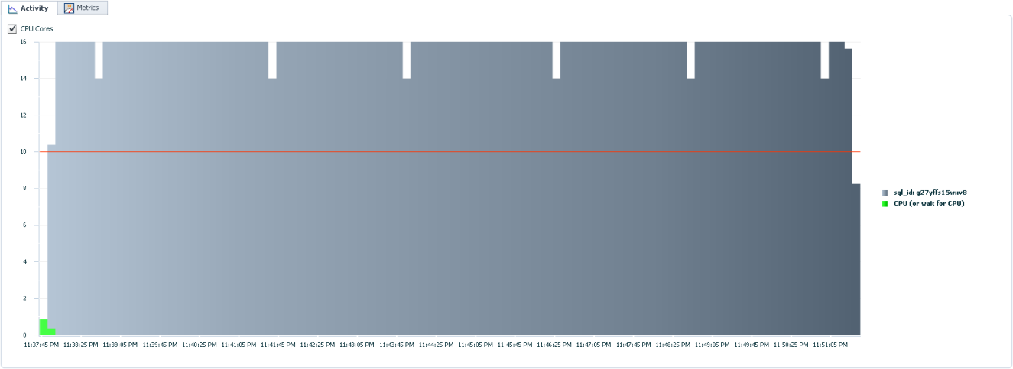
Amdahl's Law - Measure Carefully
Notes:
These pictures compare different ways to read a table in parallel. The top, colorful chart shows reading one-partition-at-a-time. The bottom, boring chart shows reading a table with a single SQL statement.
In this case, boring is good. The boring chart has very few edges, which means it's getting the most parallelism possible. If we want to improve performance by X we need to have X threads running at every possible moment.
We must have tools to measure and visualize utilization or we'd never know what's missing. This was built with SQL Monitoring Reports, but there are other ways to get this information.

Slide 35
Amdahl's Law - Parallelize Everything
Don't only parallelize INSERT or SELECT
Also spend time parallelizing:
Index rebuilding
Gathering statistics
Constraint validation
Notes:
For optimal data warehouse performance we can't have any serialization. It's not enough to parallelize the obvious SELECT, DML, and CTAS statements.
We must also parallelize those "other" operations that aren't our primary objective. It's trivial to parallelize index rebuilding and statistics gathering, we just need to enable some settings. Parallelizing constraint validation is a bit trickier (disable constraint, set table to parallel, enable novalidate the constraint, validate the constraint, remove the parallelism) but it's worth the effort to get maximum parallelism.

Slide 36
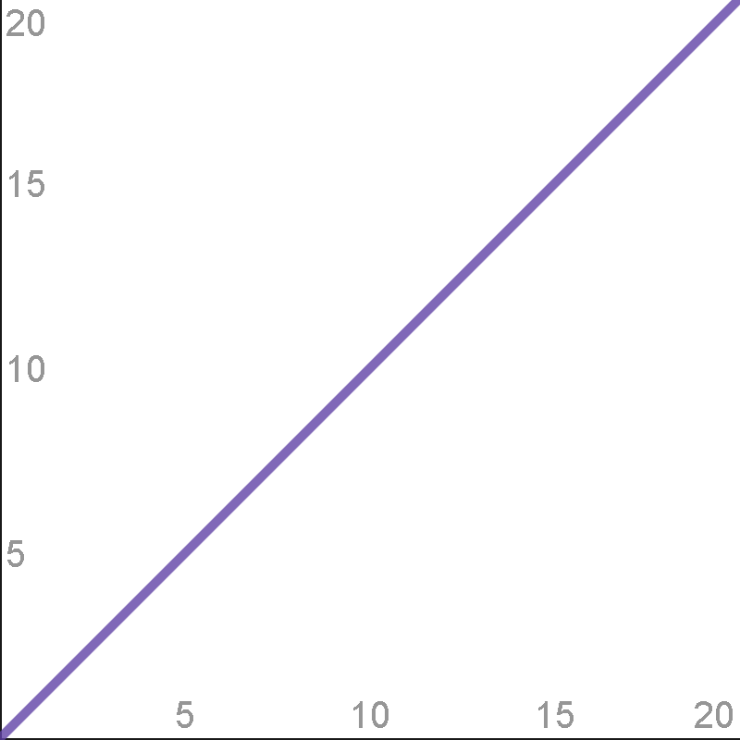
N

Slide 37
N - Linear Growth
Full table scan, fast full scan, parsing, basic compression, DML, etc.
In practice, most common function
Most effort is spent here
2x improvement is nice
Now it's time to compare functions
Notes:
Linear growth is the most common and occurs in many operations. This presentation covers a wide range of complexities, but in practice, most of our work is linear.
Changes like using direct-path writes are "only" something like a 2x improvement, but that's still pretty awesome.

Slide 38
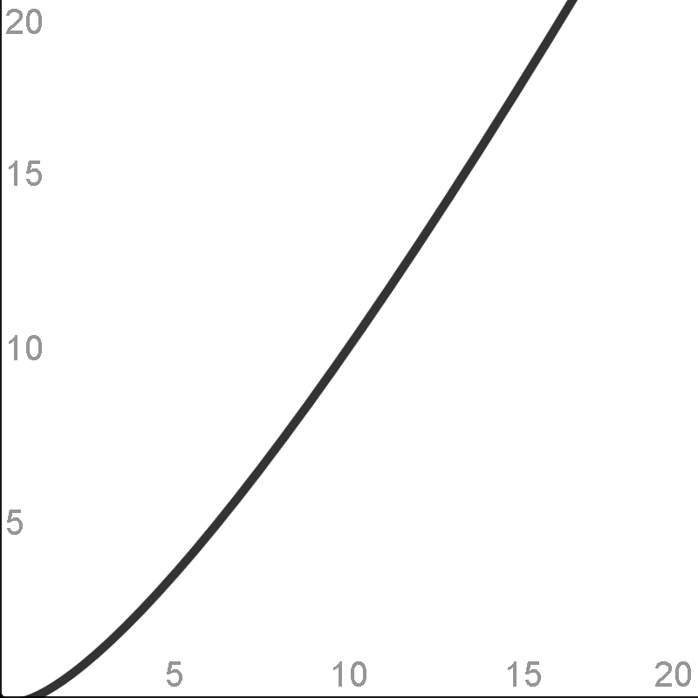
N * LOG(N)

Slide 39
N * LOG(N) - What and Where
Combining O(N) and O(LOG(N)):
Index access for multiple rows
Sorting
Joining
Local index (partitioned indexes)
Gathering statistics (distinct)
Notes:
We've seen many operations that happen in O(N), and many operations that happen in O(LOG(N)). When we combine them we get O(N*LOG(N)).

Slide 40
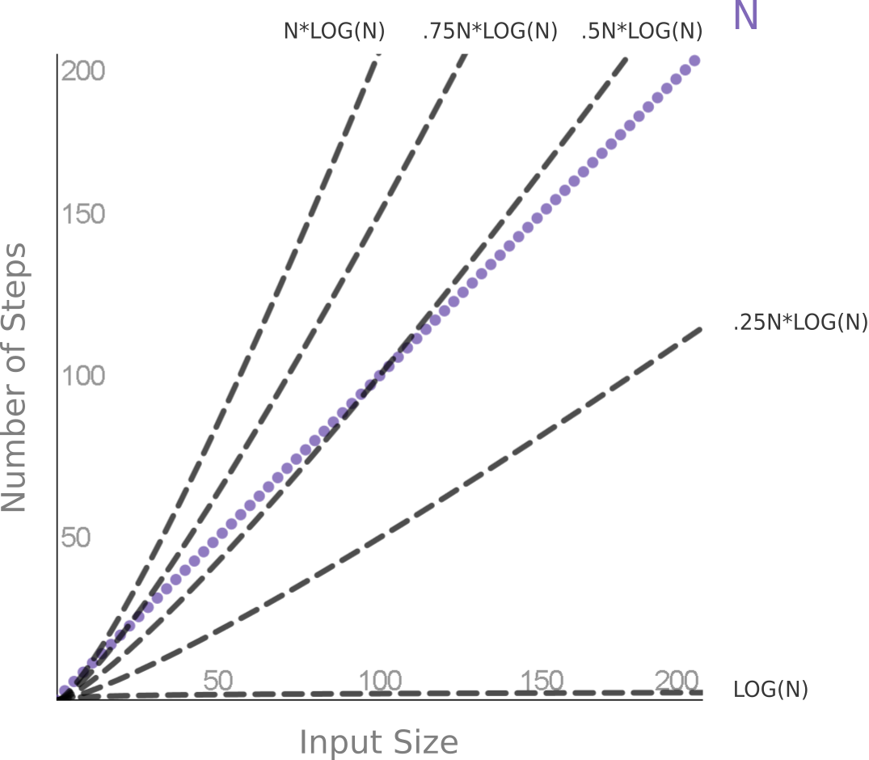
N * LOG(N) - Full Table Scan vs. Index
Notes:
Difficult choice: It's not obvious when a full table scan is cheaper than an index read. It depends on the percentage of the index and how big the data is.
Other factors: Clustering factor, multi-block versus single-block read time affect the choice.
Theory versus practice: Theory tells us the *shape*, but practice tells us the actual number where they diverge.
Cardinality: This is why cardinality is important. Oracle must know where on the X-axis we are, to know which choice is better.

Slide 41
N * LOG(N) - Sorting
ORDER BY time does not grow linearly
Memory/temp tablespace grows linearly
Index full scan - do sorting ahead of time
Notes:
Sorting is expensive and grows even more expensive. For example, if it takes 10 seconds to sort a table, when the table doubles, you should expect it to take more than 20 seconds.
However, the space required in the PGA or temporary tablespace appears to grow linearly, and is about equal to the size of the data sorted.
Sorting is expensive and we can avoid that sorting by using an index full scan.

Slide 42
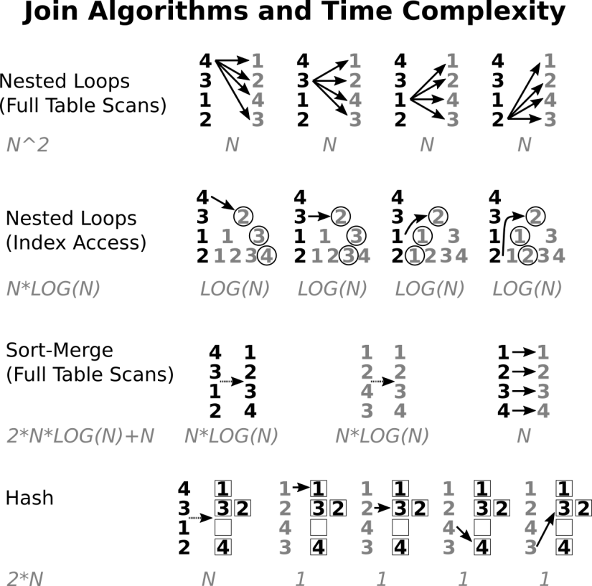
N * LOG(N) - Joining
Notes:
Spend time understanding this: This visualization briefly shows many of the most popular join methods. It might be worth going back and looing at these algorithms and data structures, and understanding how they work.
N * M: Although algorithm analysis often uses N for both table, in reality there are two different numbers.
Complexity hides up-front cost: Although hash join has the lowest run-time complexity, it also requires a lot of up-front work. It's not worth the cost if either N or M is small.

Slide 43
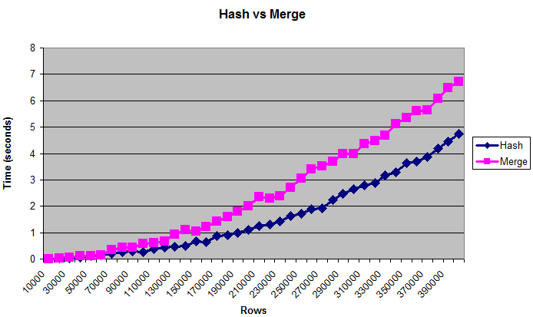
N * LOG(N) - Hash vs. Merge
Hash is worse than O(2N), but better than O(N*LOG(N))
Notes:
Both hash joins and sort-merge joins are best for large data sets. In practice, we always want to use a hash join if it's available.
I don't know the exact complexity of hash joins, it's somewhere between O(2N) and O(N*LOG(N)). Whatever it is, it's better than a sort-merge join.
Chart is based on my answer here: https://stackoverflow.com/questions/8188093/oracle-always-uses-hash-join-even-when-both-tables-are-huge

Slide 44
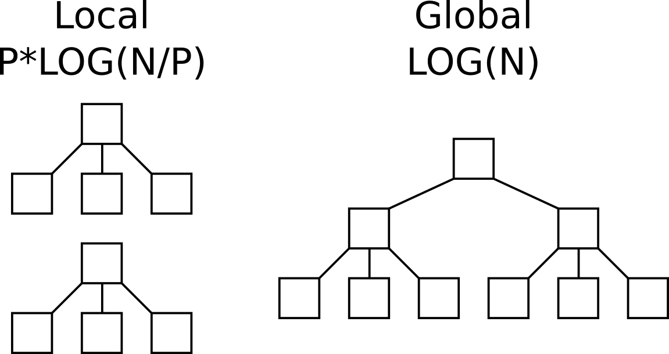
N * LOG(N) - Local vs Global Indexes
Notes:
Indexes are great, and partitioning is great, but adding them together doesn't work as well as you might expect.
Indexes grow very slowly. It's much better to have one large index access than multiple small index accesses.
Global indexes are often better than a local index, unless that local index can be partition pruned and only one is accessed.

Slide 45
N * LOG(N) - Gathering Statistics
Counting distinct is like sorting - O(N*LOG(N))
Cardinality vital, but estimate good enough
Approximate NDV is O(N) instead of O(N*LOG(N))
Always use default for ESTIMATE_PERCENT
Incremental statistics - adding NDV, birthday
Notes:
Counting the number of distinct items is very expensive. It may require O(N*LOG(N)) sorting, or hashing which is still slow.
Cardinality is vital to good performance, so the optimizer knows how expensive things will be. But the optimizer can make great decisions even if it's off by a factor or 10. In this case, perfect is the enemy of good enough - we only need cardinality estimates.
Oracle implements an algorithm called HyperLogLog to create an approximate Number of Distinct Values by only scanning the table once. (The details of that algorithm don't matter here.)
Those approximate algorithms might have to read more of the table - they read the entire table instead of an estimate. But O(N) full table scan can be better than O(N*LOG(N)) for a sample. So you almost always want to use the default ESTIMATE_PERCENT when gathering statistics.
A similar issue happens with gathering partition statistics. Oracle has to gather statistics for each partition, and for the entire table. The number don't simply add up. For example, if the partitions include birthdays, we can't find the distinct number of birthdays by simply adding together the distinct count of each partition. But Oracle's incremental statistics creates a faster way to add distinct estimates. So we can gather statistics just once per-partition, and then simply add them to get the global statistics.

Slide 46
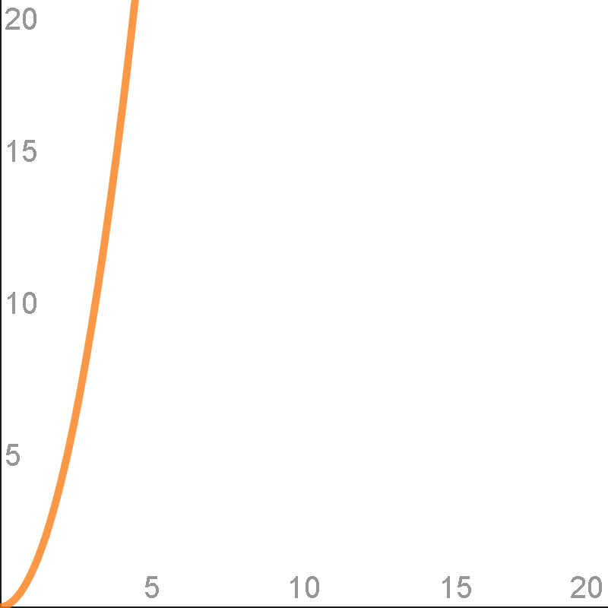
N^2
Notes:
* O(N^2) is getting ridiculously expensive. We must be very careful whenever we're in this performance territory.

Slide 47
N^2 - What and Where
Nested loops: ------------------------------------ | Id | Operation | Name | ------------------------------------ | 0 | SELECT STATEMENT | | | 1 | NESTED LOOPS | | | 2 | TABLE ACCESS FULL| TEST1 | | 3 | TABLE ACCESS FULL| TEST2 | ------------------------------------
Avoid home-made joins in PL/SQL: FOR i IN 1 .. TEST1.COUNT LOOP FOR j in 1 .. TEST2.COUNT LOOP
MODEL clause
parse time for 500+ UNION ALL
Notes:
Execution plans with NESTED LOOPs can be extremely slow if both of them are full table scans. Comparing every row in one table with every row in another table is terrible for performance.
Using embedded FOR loops creates a nested loop. This is why looping through cursors in cursors is a terrible idea. The optimizer can re-write nested joins into an optimal plan. Oracle cannot re-write across PL/SQL, and it's easy to create N^2 solutions if we build joins in PL/SQL.
The MODEL clause in powerful because it allows multidimensional arrays and procedural code in SQL. But looping through a multidimensional array can easily be O(N^2). The more nested loops, the worse the algorithm. However, looping is not always evil. I once built an O(N^4) MODEL clause, but it was still much faster than the equivalent procedural solution, because the query avoided context switching and was easily parallelized.
Oracle's parser is excellent and can compile code much faster than most languages. However, in extreme cases, the parse time grows exponentially. For example, using more than about 500 UNION ALLs in a single statement becomes extremely slow. Remember our lesson from 1/N - we don't need to combine 500 rows-at-a-time, 100 is good enough.

Slide 48
N^2 - Why it Matters
N^2 is horrible, avoid at all costs
Except near 0 where constants dominate (cross joins are not always evil)
Notes:
* Don't look at execution plans and always remove all NESTED LOOPs with full table scans, or all CROSS JOINs. Sometimes those methods are the fastest.

Slide 49
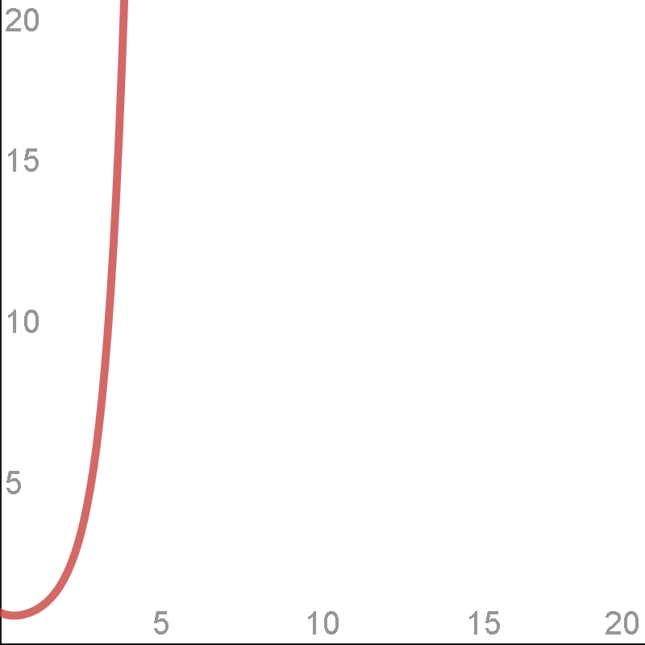
N!
Notes:
Factorials are rare but happen more often than we might think.

Slide 50
N! - What and Where
N factorial: 3! = 3 * 2 * 1
Grows quickly: 5! = 120, 10! = 3,628,800
Occurs when listing all possible orders
Optimizer when finding join order
Our memory/attention when visualizing join order
Notes:
In old versions of Oracle, when the Cost Based Optimizer was new, we did occasionally have to set a hidden parameter to limit the number of joins considered. But I haven't had to do that for almost a decade now. Modern versions are good enough to know when to stop looking at join orders.
A more realistic concern is with the code we create. The scarcest resource is not processing power, memory, or disk space - it's developer attention.

Slide 51
N! - Why it Matters
2 small sets is less complex than one big set
10! >> 2 * 5!
Pseudo-code: select * from table1, table2, table3, table4, table5, table6, table7, table8, table9, table10 ... versus: select * from ( select * from table1, table2, table3, table4, table5 ... ) view1 join ( select * from table6, table7, table8, table9, table10 ... ) view2 on view1.something = view2.something
Notes:
Good SQL programming is about creating small, understandable chunks of code, and then combining those chunks into new chunks, and repeating.
Even though the second example uses more characters, more keywords, and more joins, it is much simpler than the first. Nobody can keep a 10-join query in memory. Even a 5-join query is tough. If we build our query 3-to-4 joins at a time, and then join the inline views, all the chunks of our code will be easy to understand.

Slide 52
∞ - Why it Matters
Halting problem is O(∞)
Optimizer is really a satisficer
Don't expect miracles
Work with the forecast, don't throw it out because of a few bad examples
Gather stats manually and automatically
Notes:
The halting problem asks the question: can a program determine if another program will ever finish? Before computers and programs were invented, Alan Turning proved that the answer is "no". There will never be an algorithm that can always predict whether another algorithm will even finish. Note that the optimizer job is even more complicated - it doesn't merely need to determine if a query will finish, it needs to determine how long different paths will take. This is a problem that is impossible to solve in theory, but solvable by the optimizer in practice.
To make the optimizer's job even more complicated, it also has to optimize in a limited amount of time. The optimizer must take it's own time into account. There's no point in spending an hour to find the optimal solution to a 5-second query. This behavior isn't just optimizing, it's satisficing.
It's important to understand that the optimizer has a tough job so we don't expect miracles. We should expect *any* optimizer to make a few mistakes. Don't throw out the system and think you can do it better yourself just because you find one slow query.
When I worked at a forecasting company the unofficial motto was "the forecast is always wrong". We should never expect perfection, and we should not try to over-correct. For example, a lot of people will see a query that's not using an index, and adjust the entire system with a parameter like OPTIMIZER_INDEX_COST_ADJ. Changing that parameter is like always adding 10 degrees to the weather forecast because a single forecast was wrong by 10 degrees. Adding 10 may help with one specific problem but it will not help on average.
In practice, this means that everyone needs to worry about statistics. Neither developers nor DBAs can handle statistics all by themselves. Statistics must be gathered manually after any process that changes a significant percent of the data. And statistics must be gathered automatically by the system, to catch gradual growth and a few missed objects. If the automatic statistics jobs are not working well, try using DBMS_STATS to set preferences before you roll your own.

Slide 53
Summary
Programs = Algorithms + Data Structures
Computer science degree not necessary
A few simple functions explain most behavior
Constants can't always be ignored
Algorithm analysis is foundational to understanding performance
Notes:
To understand how our SQL statements are executed we must understand the algorithms and data structures. Each line of an execution plan is really a tiny program, with an algorithm (the operation) and a data structure (the object).
Algorithm analysis may be taught in computer science courses but it's available to any developer, and only requires high school math skills.
This presentation covered 9 functions that describe most Oracle operations.
In the real world most of our time will be spent worrying about constants. In our day-to-day performance tuning, linear improvements are most common and usually good enough. Those pesky constants we've been ignoring cannot always be ignored.
Our performance tuning toolkits need many different tools. The most popular tools will be SQL tuning, cardinalities, execution plans, MOS, Google, etc. But to truly understand performance problems it helps to know the algorithmic complexity.

Slide 54
Questions?
jon@jonheller.org
281

